Slide 1
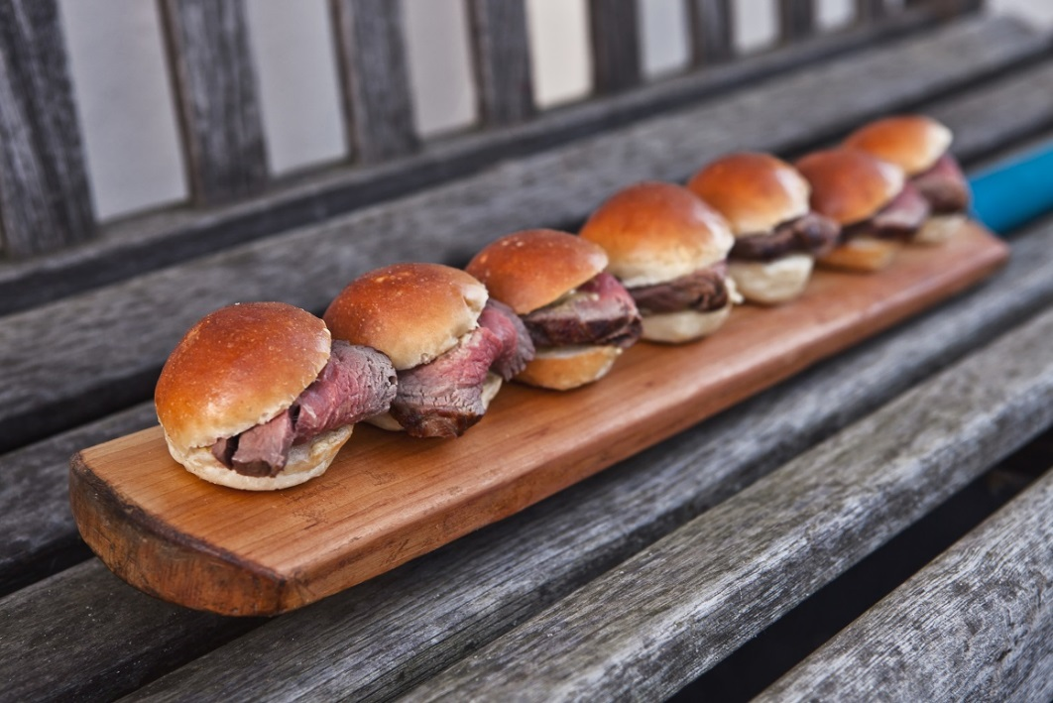
BOWL FOOD/SMALL PLATE “CLASSICS”
This a la carte menu offers a wide range of “plates” and “bowls” suitable for easy eating at a stand up networking/grazing style event.
We recommend five savoury dishes and two desserts per person and invite you to make your own selection from the following list.
Meat Based Dishes
Braised Beef Cooked In Stout
Button Onions & Wholegrain Mustard Croutes
Lamb Kofta
Baba Ganoush
Chargrilled Chicken
Lemon, Basil and Rocket
Crispy Duck Spring Rolls
Fried Seaweed and Hoisin
Pulled Pork Sliders
Red Cabbage Slaw
Angus Beef Sliders
Brioche Buns and Tomato Relish
Thai Green Chicken Curry
Jasmine Rice
Chorizo Scotch Eggs
Romesco Sauce
Fish Based Dishes
Fishmongers Pie
Cheesy Mashed Potato Topping
Crayfish Cocktail
Marie Rose Dressing
Salmon “Dogs” in Brioche Buns
With Pea Purée
Sole, Shrimp and Mango Salad
Oriental Dressing
Smoked Haddock Fish Cakes
Tartare Sauce and Baby Leaves
Scottish Smoked Salmon
Soda Bread Fingers
Roast Beef
In Brioche Buns
@ £X per person

Slide 2
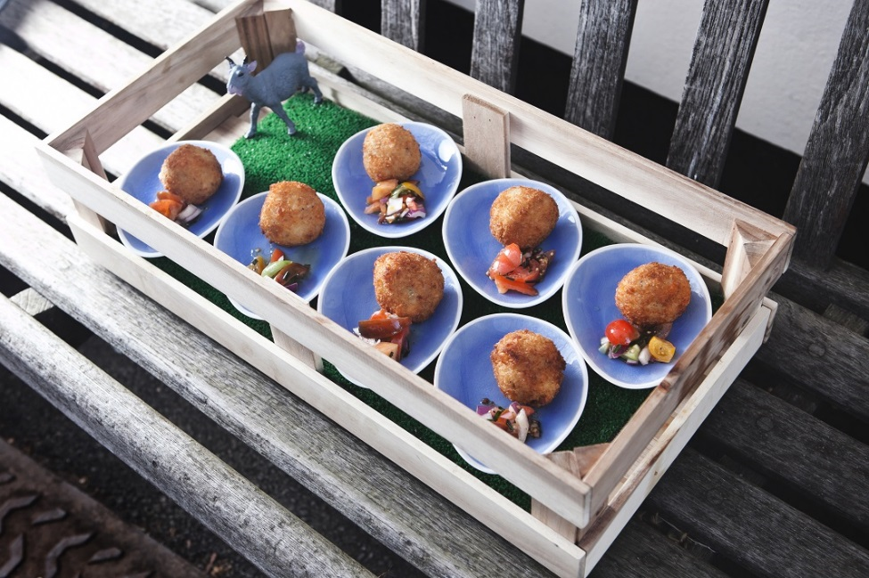
86 BOWL FOOD/SMALL PLATE “CLASSICS”
Mini Pizza Selection
Tomato and Mozzarella
Artichoke and Olive
Mushroom Salad
With Croutons, Red Currants and Sour Cream
Butternut and Pine Nut Arancini
Rocket and Sour Cream
Mac and Cheese
Charred Cauliflower
Spinach and Feta Pancakes
Fresh Tomato Sauce
Tomato, Mozzarella and Avocado Salad
Pesto Dressing
Desserts
Mini Treacle Tartlets
Lemon Crème Fraîche
Mango and Raspberry Kebabs
Cardamom Dipping Sauce
Passion Fruit Pavlovas
Cranberry Cream
Strawberry and Raspberry Eton Mess
Mini Banoffee Pies
Double Chocolate and Cherry Brownies
Pimm’s No.1 Ice Cream Shots
Chocolate and Raspberry Eclairs
Vegetable Based Dishes
Bubble and Squeak
With Fried Quails Eggs
Chicory, Pear and Gorgonzola Salad
Lemon Dressing
Butternut and Goat’s Cheese Arancini
Heritage Tomato Concasse
Add Pre-Dinner Canapes from £6.00 +VAT pp
(please contact us for further information)

Slide 3
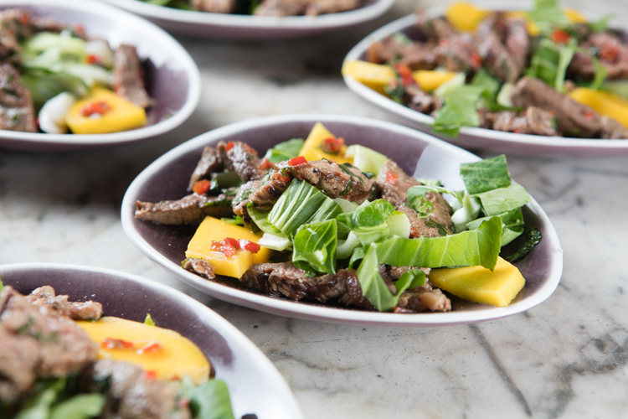
87 GOURMET BOWL FOOD/SMALL PLATE
This a la carte menu offers a wide range of “plates” and “bowls” suitable for easy eating at a stand up networking/grazing style event.
We recommend five savoury dishes and two desserts per person and invite you to make your own selection from the following list.
Meat Based Dishes
Rack of Welsh Lamb
Minted Quince Jus
Roast Fillet of Aberdeen Angus
Dauphinoise Potatoes and Cèpe Armagnac Reduction
Smoked Duck Breast and Peach Salad
Manzanilla Dressing
Serrano Ham
Manchego, Artichoke, Pomodoro Tomato
Coconut Lamb Lollipops
Fresh Mint Salsa
Oriental Beef Fillet and Papaya Salad
Star Anise Dressing
Chargrilled Chicken
Wild Rice, Minted Yogurt and Pomegranate
Cured Venison Fillet
Caramelised Cranberries and Thyme
Fish Based Dishes
Tandoori Cod
Saffron Rice and Tomato Chilli Chutney
Shrimp, Kohlrabi and Apple Salad
Sesame Seed Dressing
Seared Sea Bass
Caramelised Fennel and Balsamic Reduction
Lobster Ravioli
Herb Broth
Sole and Salmon Ceviche
Orange, Avocado and Watermelon
Seared Scallops
Broad Bean Purée and Citrus Butter
Oriental Beef Fillet and Papaya Salad
Star Anise Dressing
@ £x per person

Slide 4
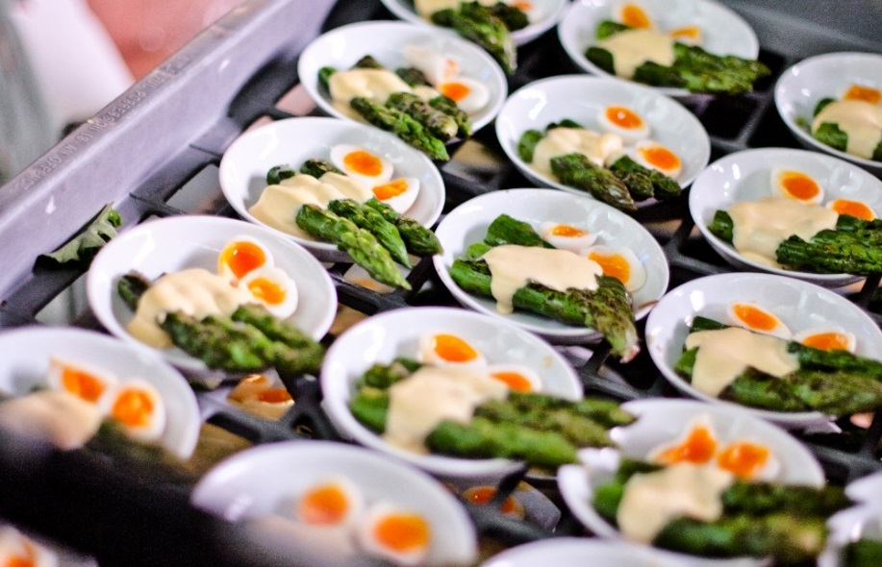
87 GOURMET BOWL FOOD/SMALL PLATE
Vegetable Based Dishes
Parmesan Choux
Aubergine Caponata and Green Olive Tapenade
Black Truffle and Camembert Soufflé
Heirloom Tomatoes
Burrata and Basil Oil
Pumpkin and Sage Tortellini
Caper Sauce
Chanterelle Mushroom Risotto
Shaved Parmesan
Chargrilled Asparagus and Quails Eggs
Sauce Hollandaise
Superfood Salad
Quinoa, Broccoli, Brazil Nuts, Pomegranate
Keralan Vegetable Curry
Basmati Rice and Courgette Raita
Desserts
Dark Chocolate Honeycomb
Minted Mascarpone and Raspberry Dust
Orange Panna Cotta
Basil Beignet
Raspberry and Tarragon Meringues
Filled with Drambuie Syllabub
Lemon and Almond Tartlets
Passion Fruit Cheesecakes
Rhubarb and Orange Profiteroles
Chocolate and Grand Marnier Truffle Cake
Tiny Cappuccino Crème Brûlée
Pearls of Fresh Fruit Sorbets
Dipped in White and Dark Chocolate
Mini Triple Chocolate Mousse Shots
Chargrilled Asparagus and Quails Eggs
Sauce Hollandaise
Add Pre-Dinner Canapes from £6.00 +VAT pp
(please contact us for further information)

Slide 5
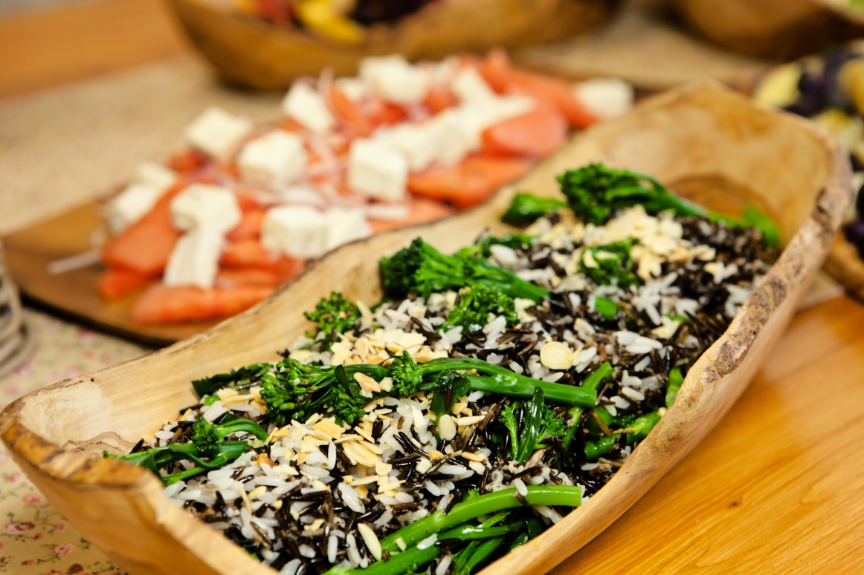
88 FOOD STATIONS/GRAZING MENU
This menu offers an interesting variety of food stations from which your guests can choose a range of easy-to-eat dishes, to meet all tastes.
We invite you to choose 3 savoury stations plus 1 dessert.
SAVOURY IDEAS
Sliders Station
Angus Beef Sliders
Marinated Chargrilled Chicken Sliders
Chickpea and Sweet Potato Pattie Sliders (v)
Served with Béarnaise, Spicy Tomato Relish, Horseradish and Mustard
Salad Bar
Feta, Broccoli and Beetroot (v)
Toasted Sunflower Seeds
Lentil and Roasted Vegetable Salad (v)
With Thyme Dressing
Watercress and Rocket Salad (v)
Blood Orange and Croutons
Saffron Rice Salad (v)
Toasted Almonds, Peas and Pomegranate
Heritage Tomato, Asparagus and Burrata (v)
Basil Dressing
Coastal Waters
Dorset Crab Cakes
Saffron Crème Fraiche
Billingsgate Haddock and Spinach Pie
Cheesy Mustard Potato
Cornish Seabass
Rock Samphire, Tarragon Béarnaise
Skewers Selection
King Prawn and Mango
Grilled Beef with Mushroom and Tomato
Chicken Satay
Fried Halloumi, Courgette and Aubergine (v)
Wild Rice with Broccoli Florets
Toasted Almonds
@ £X per person

Slide 6
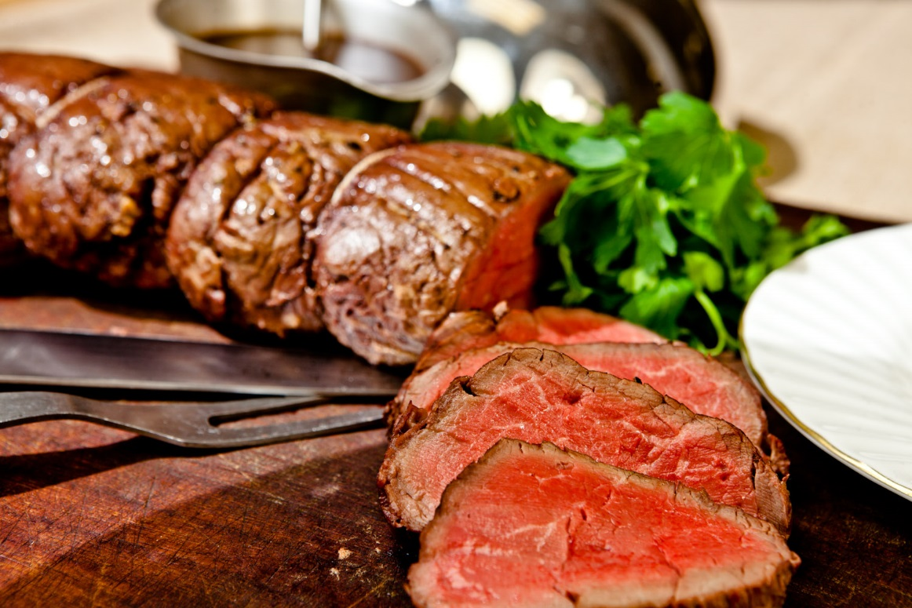
88 FOOD STATIONS/GRAZING MENU
Pulled Pork
Slow Cooked Gloucester Old Spot
Served in Ciabatta Rolls with:
Caramelised Apple; Sage Salsa; Cepe Mustard
Carrot and Celeriac Coleslaw
Best of British
Rare Fillet of Hereford Beef
Carved by Uniformed Chefs into Mini Brioche Buns
Norfolk Asparagus (v)
Laverstoke Mozzarella and Basil Oil
Smoked Trout
Served with Broad Bean and Pea Salad, Citrus
Best of Scotland
Arbroath Smoked Kedgeree
Apple and Chicory Salad
Wild Mushroom Salad (v)
With Chanterelles and Croutons
Smoked Venison
Thyme Roasted Butternut and Baby Beets
Best of Wales
Cannon of Carmarthenshire Lamb (Carved by Uniformed Chefs)
Served with Leek and New Potato Salad
Smoked Mackerel
Little Gem, Cherry Tomato
Caramelised Leek and Caerphilly Tartlet (v)
Chive Crème Fraîche
Best of Ireland
Smoked Salmon and Chives
Soda Bread
Beef and Stout Pie
Champ Potato Topping
Heritage Carrot with Bean and Fennel Salad (v)
Hazelnut Dressing
Best of British
Rare Fillet of Hereford Beef Carved by Uniformed Chefs on the Buffet
@ £X per person

Slide 7
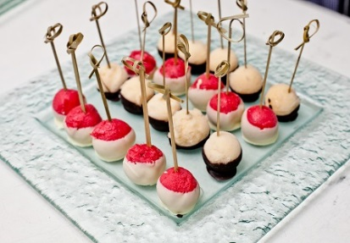
88 FOOD STATIONS/GRAZING MENU
DESSERT IDEAS
City of London Shots
A contemporary “skyscraper” display of shot glass desserts
Mini Port and Plum Trifle
Rich Chocolate Mousse with Gold Leaf
Champagne and Raspberry Jellies
Eton Mess Miniatures
Dessert Frivolities
Passed round to the guests by our waitresses
Fresh Fruit Sorbet Pearls
Dipped in White and Dark Chocolate
Cheesecake Selection
Mango and Passion Fruit
Raspberry and Tarragon
Best of British
Mini Treacle and Lemon Tarts
Rhubarb Fool
Raspberry Meringues
Fresh Fruit Brochettes
Exotic Fruits and Farmhouse Cheeses
A centrepiece display of seven farmhouse British cheeses, presented with an abundance of fresh fruits, chutneys and savoury biscuits.
Strawberries and Cream
For summertime events – an array of English strawberries and other berries served with whipped Devon cream and homemade meringues.
Fresh Fruit Sorbet Pearls
Dipped in White and Dark Chocolate
Add Pre-Dinner Canapes from £6.00 +VAT pp
(please contact us for further information)

Slide 8
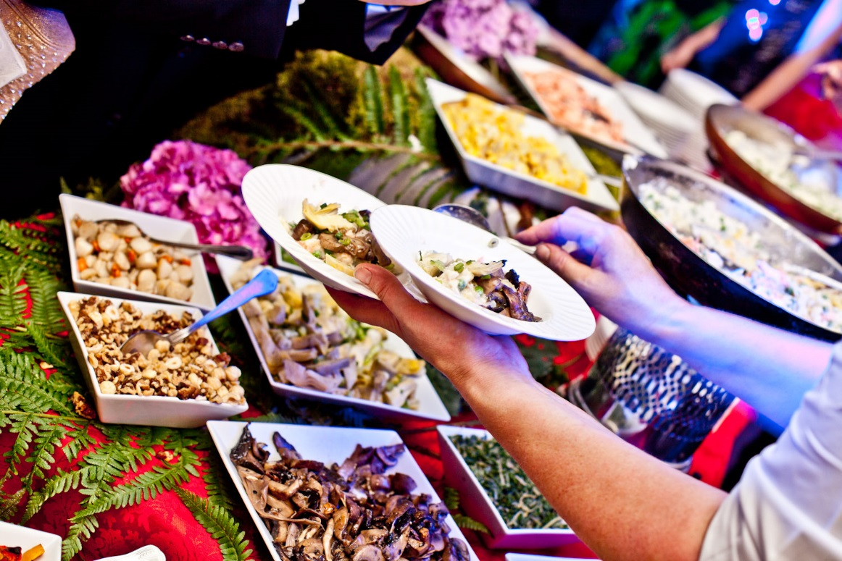
89 THEMED FOOD STATIONS MENU
These food stations feature a variety of street food and other specialities from around the world. Each station would be colourfully decorated and themed to enhance the dining experience.
We invite you to choose four savoury stations and two dessert stations to create a stylish themed party.
SAVOURY IDEAS
The Spices of India
A palatial Indian spread decorated with eastern spices and pillared with huge urns of exotic fruits
Kashmiri Lamb with Fennel and Cardamom
Dressing with Pomegranate Seeds
Mughlai Chicken
With Almonds and Sultanas
Masoor Dhal (v)
With Crispy Red Onion, Butternut and Cashews
Saffron Rice
Yoghurt Bread, Naan Bread and Poppadoms
A Selection of Chutneys, Pickles and Accompaniments
South American Carnival Roast
A Mardi Gras stall with chefs carving whole joints of meat on to wooden blocks and into a variety of speciality bread rolls
Whole Fillets of Beef with Honey and Garlic
Served with Spicy Remoulade
Saddles of Lamb Basted in Fino Sherry and Wholegrain Mustard
Served with Mint and Coriander Salsa
Salad of Continental Leaves
With Cherry Tomatoes and Sweet Peppers
The Italian Gardener
Uniformed chefs cooking and serving risotto on the station with an abundant choice of vegetable ingredients on a buffet filled with terracotta, slate and wood platters
Roasted Butternut and Thyme
Aubergine and Sweet Pepper
Rocket and Asparagus
Wild Mushroom and Truffle
Minted Peas and Broad Beans
Chestnuts
Italian Gardener Risotto Station
An abundance of ingredients to choose from
@ £X per person

Slide 9
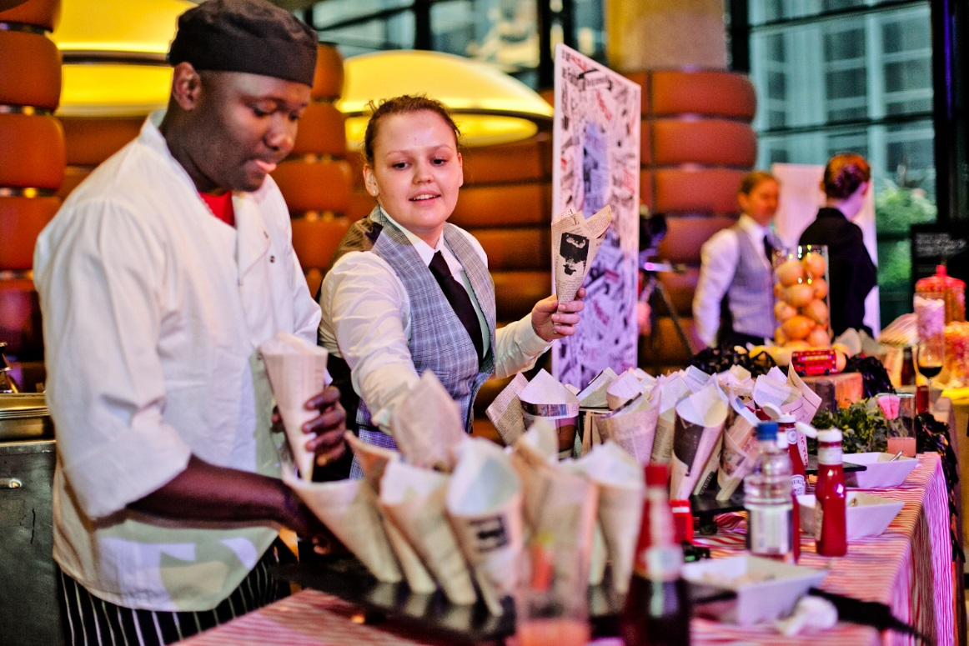
89 THEMED FOOD STATIONS MENU
Mezze Market Stall
A Middle Eastern street food market stall overflowing with an abundance of delicacies:
Prawns with Citrus and Avocado
Finished with Pine Nuts
Saffron and Mint Couscous
With Almonds and Raisins
Spicy Sausages with Borlotti Beans and Tomato
With Coriander
Chicken and Roasted Pepper Tagine
With Apricots
Aubergine, Chickpea and Feta Cheese
Bowls of Olives, Hummus and Yoghurt
Selection of Flat Breads and Rolls
Stately Home Carvery
Buffet station adorned with silverware, with uniformed chefs carving joints of meat presented individual Yorkshire puddings and offered with an array of relishes and accompaniments.
Rare Roasted Aberdeen Angus
Marinated with Mustard Seed and Horseradish
Barbecued Pork Loin
With Coxes Apple Sauce
Roasted Butternut and Aubergine
With Balsamic and Olive Oil
Traditional Fish & Chips
Served in FT paper cones on a fun seaside stall amidst towers of fresh lemons
Pollock in Beer Batter
Zucchini and Cauliflower in Beer Batter
Chips with Salt and Pepper
Ketchup and Tartare Sauce
The Stone Baked Pizza
A classic Venetian Pizza Bar serving speciality sour dough pizza cooked large and then sliced by the chef. To include:
Parma Ham, Rocket and Parmesan
Wild Mushrooms and Sour Cream (v)
Shrimp, Aubergine and Olives
Goats Cheese, Asparagus and Red Onion (v)
Boss Burgers
Chargrilled pure Angus Beef Burgers served in three-bite sesame buns with our special relish, salad and all the classics. A wholesome vegetarian burger will also be available.
Traditional Fish & Chips Station
Served in FT Paper Cones with a Selection of Sauces
@ £X per person

Slide 10
89 THEMED FOOD STATIONS MENU
Billingsgate Seafood Barrow
A superb centrepiece, this traditional painted market barrow overflowing with a lavish display of shellfish to include:
Langoustine, King Prawns, Mussels, Oysters, Smoked Halibut, Smoked Salmon, Shrimps and Clams
Served with a Selection of Seafood Sauces and Dips
China Town Noodle Stall
A colourful oriental wok cooking station decorated with Chinese lanterns, parasols and silks, with chefs serving rice and egg noodles with a variety of accompaniments
Mixed Seafood with Dill and Coconut
Chicken, Pineapple and Cashew Nuts
Tofu, Bok Choy, Sweet Pepper and Ginger (v)
Crispy Vegetable Spring Rolls
The London Pie Seller
A multi-tiered display of delicious individual savoury pies in China dishes, ready for easy eating with a fork
Lamb Shepherd’s Pie
Fishmongers Pie
Chicken and Mushroom Pie
Lentil and Pumpkin Pie (v)
DESSERTS
The Chocolate Shop
A modern tiered lavish display overflowing with
Chocolate and Grand Marnier Truffles
Bitter Chocolate Prune and Armagnac Tartlets
Black and White Chocolate Brownie
Miniature Triple Chocolate Mousses
Traditional Ice Cream Cart
Waiters offering a variety of homemade ice creams and sorbets in sugar cones from a traditional cart
Chocolate Mint Chip
Old Fashioned Vanilla
Cookies & Cream
Banana & Rum
Mango
Blackcurrant
Maple & Walnut
Peach Melba
China Town Noodle Stall
Chefs Preparing Fresh Noodles with a Variety of Accompaniments
@ £X per person

Slide 11
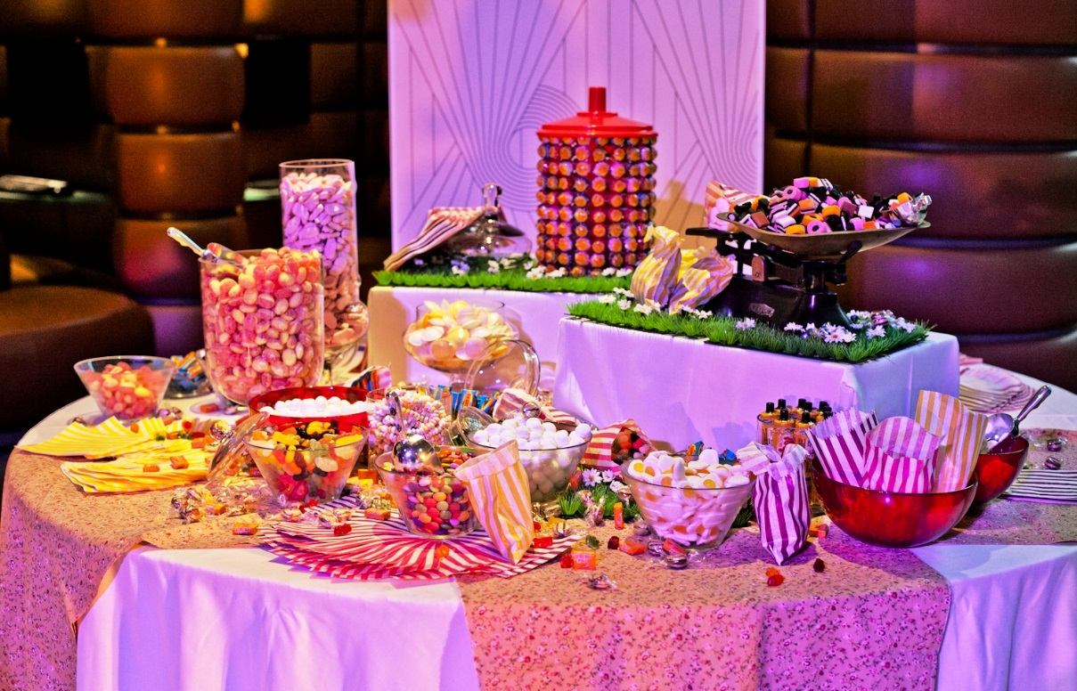
89 THEMED FOOD STATIONS MENU
Tea at the Ritz
An imaginative teatime display set out on traditional Edwardian style cake stands and silverware
Tiny Jam Sandwiches
Victoria Sponge
With Strawberries and Cream
Tiny Tartlets of Summer Fruits
Peach, Grape, Red Currants and Black Currants
Scones with Raspberry Jam
Clotted cream
Chocolate and Coffee Eclairs
Traditional Pick ‘N’ Mix Sweetshop
A selection of your favourite sweeties, displayed in Apothecaries’ jars and other glass display bowls with paper candy bags and decorative old fashioned weighing scales from which guests can help themselves throughout the evening.
Strawberry Barrow
A traditional fruit merchant’s street barrow piled high with strawberries, raspberries, blackberries and blueberries. Served with churns of Devon cream.
The Dovecote Dessert Delights
A traditional wooden dovecote which opens out to an array of exciting miniature desserts
Strawberries and Cream
Passion Fruit Meringues
Chocolate and Cherry Brownie
Shot Selection – Peach Pannacotta, Raspberry Mousse, Rhubarb Compote.
European Ultimate Cheese Counter
A lavish display of European farmhouse cheeses with an abundance of fresh fruits and berries. Served with biscuits, speciality breads, chutneys and quince curd.
Traditional Pick ‘n’ Mix Sweetshop
A Variety of Childhood Favourites
Add Pre-Dinner Canapes from £6.00 +VAT pp
(please contact us for further information)

